Slide 1
Collections
Hy-Tech Club: Python 201

Slide 2
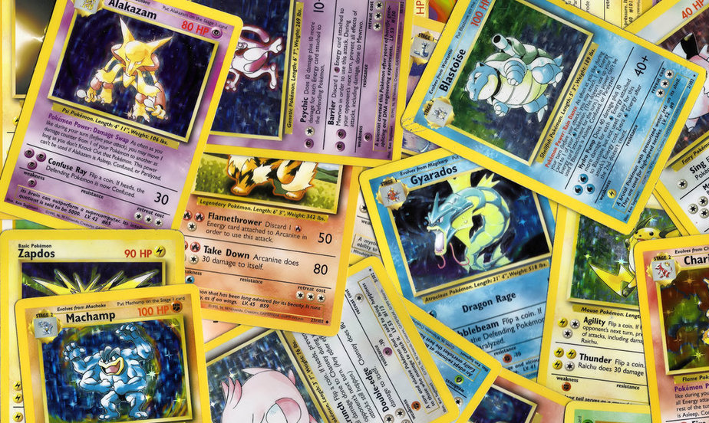
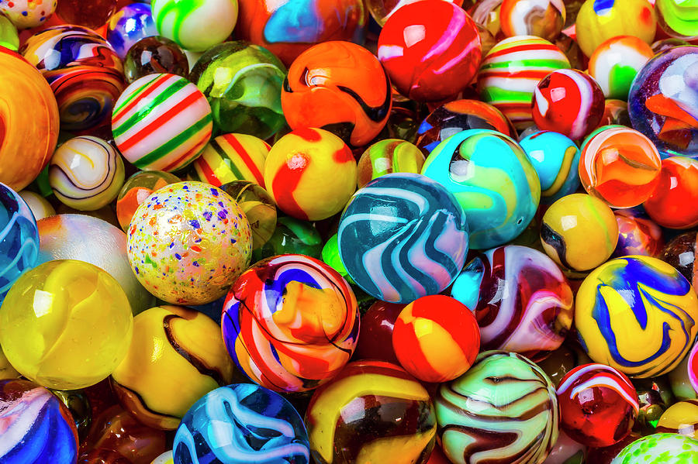
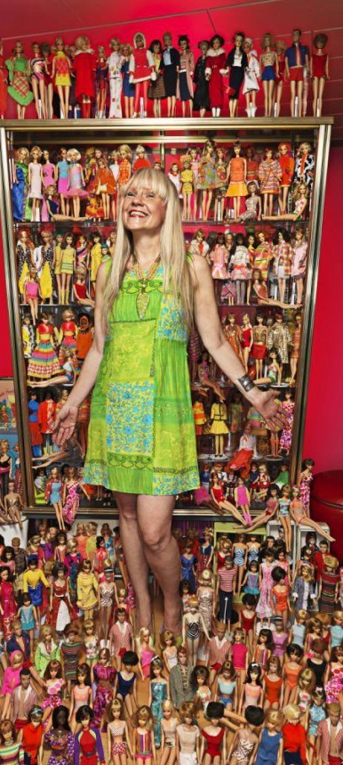
What are some things you might collect?
Notes:
Ask the question to the students – see if they have any interesting ideas.
Pictured: Pokemon cards, marbles, barbie dolls
Other ideas: Stamps, Coins, cans, art, sports memorabilia, hats, shoes, albums

Slide 3


Collections in Python
Lists
Dictionaries
Tuples
Sets
Notes:
There are four main collections in Python. We will focus on lists and dictionaries.
Tuples and Sets are other data types in Python, but we will not discuss them.

Slide 4

Lists – Creating, Adding, Accessing
pokemon
poke1
num_pokemon
Pikachu, Ditto
Pikachu, Ditto, Charmander
Pikachu, Hitmonlee, Charmander
pokemon = ["Pikachu", "Ditto"]
pokemon.append("Charmander")
poke1 = pokemon[0]
num_pokemon = len(pokemon)
pokemon[1] = "Hitmonlee"
Pikachu
Charmander
Notes:
Walk through the lines of code that create a list, update it, and access values from it. Students should be familiar with lists, and the syntax in python is very similar to C# and JavaScript. The biggest difference is using “append”, but it works just like “push” or “add”.
Make sure to ask the students for values along the way.

Slide 5
For Loop in python – a for each
pokemon = ["Eevee", "Squirtle"]
for poke in pokemon:
print(poke)
for <var> in <list>:
<do something with var>
var = list[0]
… do stuff with var
var = list[1]
… do stuff with var
var = list[n]
… do stuff with var
Output
Eevee
Squirtle
Notes:
Explain how the for loop works in Python. It works like a foreach loop in other languages. Start with an example: a list contains two pokemon. The program loops through each (setting the variable as “poke”) and then prints it. The output is the values in the list.
The syntax is for … in … :
The loop sets the <var> keyword to the current value in the list (until it reaches the end of the list)

Slide 6
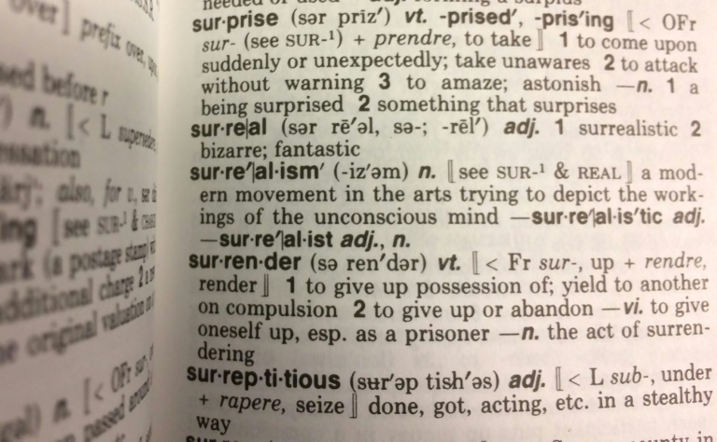
Dictionaries – a lot like objects
Python dictionaries store data in key-value pairs (no order)
Each word has a definition
surprise: to attack without warning
surreal: bizarre; fantastic
surrender: to give up or abandon
Each key has a value
type: electric
name: Pikachu
Notes:
Explain dictionaries through the concept of English dictionaries: each word has a definition. Ask the students for some word definitions, then reveal the answers.
Similar to a physical dictionary, in a Python dictionary, each key has a value. For example, a pokemon could be stored in a Python dictionary by mapping properties to values.

Slide 7

Dictionary example – A Pokemon
pika = {
"type": "electric",
"name": "Pikachu"
}
pika["hp"] = 50
me = pika["name"]
print("hi, I am " + me)
print(pika)
pika
type | electric
name | Pikachu
hp | 50
me
Pikachu
hi, I am Pikachu
{"type": "electric", "name": "Pikachu", "hp": 50}
Notes:
Running the pika = { } block will create a new dictionary named pika. The dictionary will have two key-value pairs: type -> electric and name -> Pikachu.
Setting the “hp” key to a value of 50 will add it to the “pika” dictionary.
Accessing the “name” key will return the value, and store it in the “me” variable.
Printing out a message will use the “me” variable.
Printing out the whole “pika” dictionary will display all the key-value pairs.

Slide 8
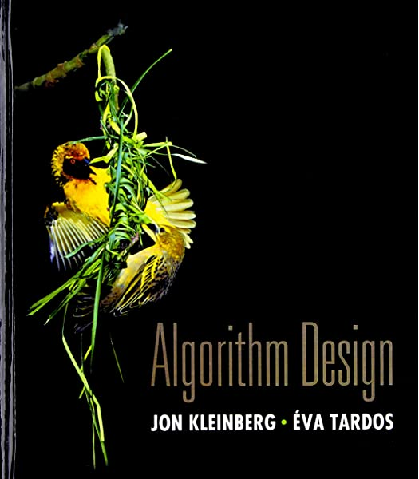
A
L
G
O
R
I
T
H
M
S
Notes:
Now we’ve talked about some data structures… but how can we use them?
Show the animation – sorting the letters of the word ALGORITHM alphabetically.

Slide 9
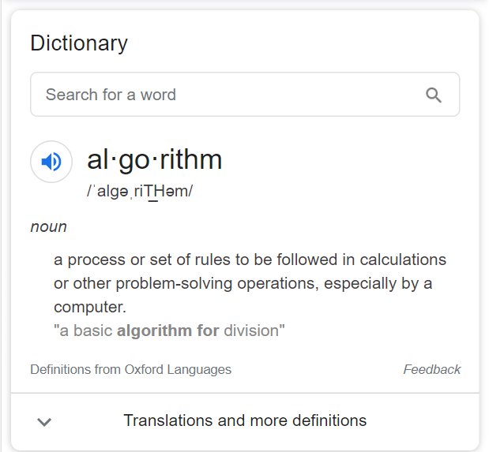
What is an algorithm?
Algorithms are the theory behind problem solving
Algorithms are not code
Algorithms are not specific to any one language
Algorithms rely on data structures, such as:
Lists
Dictionaries
Notes:
Ask the students if they know what an algorithm is. Show the dictionary definition, and explain a little bit about algorithms. Emphasize that algorithms are theory that can be implemented.
Algorithms themselves are not code; however, developers write code USING algorithms.
Ask students if they can name any data structures (hint: we just talked about two)

Slide 10
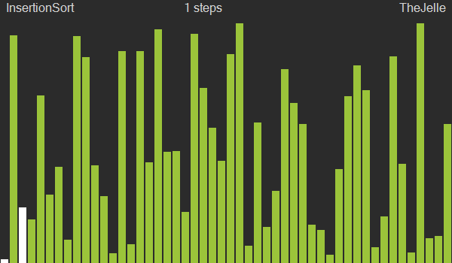
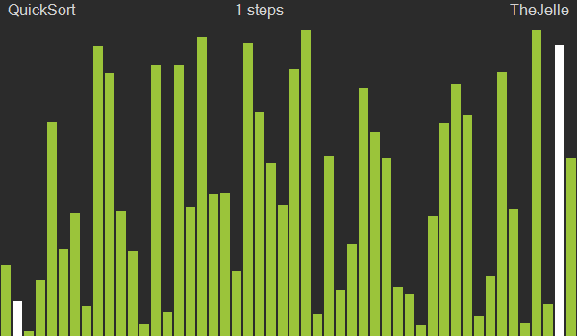
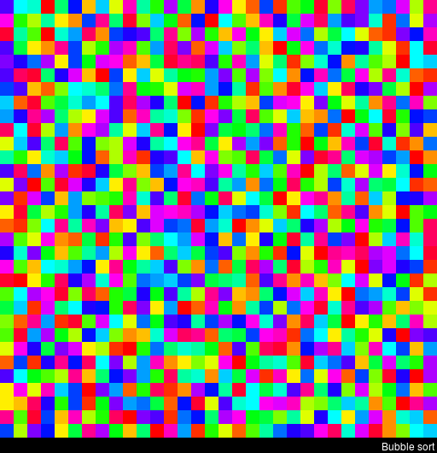
List Sorting Algorithms
Algorithms that sort lists are fundamental in computer science
If you decide to pursue a degree in CS, you will see sorting algorithms
The goal is to put elements of a list in a certain order
The efficiency of these algorithms are very important
This is referred to as computational complexity or time complexity
There are dozens of sorting algorithms out there – examples:
Notes:
Explain the basic idea of a sorting algorithm. Note that students will not have to come up with their own algorithms for sorting – they will just be using existing algorithms.
Reference: https://en.wikipedia.org/wiki/Sorting_algorithm

Slide 11

Selection Sort – a doable implementation
10, 5, 8, 3, 2, 9, 4
Pseudocode
For all elements:
Get remaining list
Find min element in list
Swap current with min
2, 5, 8, 3, 10, 9, 4
Find the smallest value index in the list
Swap that value with the current element
Repeat with the rest of the list
Time Complexity
n²
Notes:
Explain a bit about selection sort. This is what the code along activity will actually use, so it is perhaps the most important algorithm to cover.
Explain the example list, and walk through the basic steps.
Show the visualization of how it works.
Talk through the pseudocode a bit – this will be useful for the code-along.
Mention the time complexity – it’s not very fast, but it works on small lists.

Slide 12
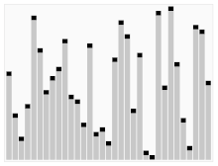
Quicksort – a quicker method
Pick a “pivot” element from the list
Put all smaller elements in a sublist
Put all larger elements in another sublist
Sort sublists using Quicksort
Pseudocode
Choose a random element (p)
Create two sublists (A, B)
For all elements:
If current > p:
Add current to A
Else:
Add current to B
Sort A and B, placing p between them
Time Complexity
n log(n)
Notes:
Explain BRIEFLY a bit about quicksort. It is a quicker way, but it’s more complex
Walk through the basic steps.
Show the visualization of how it works.
Talk through the pseudocode a bit.
Mention the time complexity – it’s significantly faster than selection sort.

Slide 13
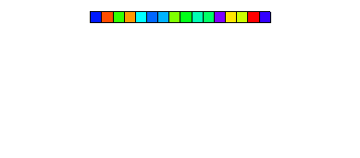
Merge sort – divide and conquer
Split the list into one-item lists
Merge each list in order
Compare the first two elements
Add the smallest one to the merged list
Pseudocode
Split the list into single-element sublists
For each pair of sublists:
Make merged list A
Merge the lists:
Compare first elements
A.add(smaller element)
Repeat
Repeat
Time Complexity
n log(n)
Notes:
Explain BRIEFLY a bit about merge sort. This is another popular method. Divide and Conquer!
Walk through the basic steps. Explain that “Merging” a list is quicker because the sublists are already in order, it simply needs to compare the first two elements
Show the visualization of how it works. This may require some waiting to show the interesting part of the sort.
Talk through the pseudocode a bit. It’s a little tough to explain, hopefully the visualization makes more sense.
Mention the time complexity – it’s about the same as quicksort. Technically quicksort is n squared (in the worst case), so this has that advantage – but it depends on the data set.

Slide 14

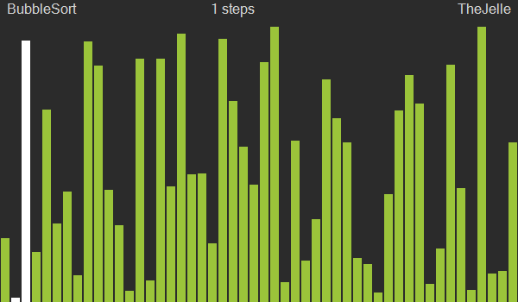
Bubble Sort – a primitive algorithm
One of the earliest sorts
Compares every element to find maximum, then repeat
Ultimately very slow
Notes:
GO over this briefly.

Slide 15
Rabbit hole: Dumb sorting
Notes:
Now let’s cover some sorting algorithms that have no practical usefulness whatsoever.

Slide 16

Bogosort / permutation sort / stupid sort …
Check if the list is already sorted
If it is, we’re done!
If it’s not, randomize the order
Repeat until list is sorted!
But quantum computing is faster…
Quantum Bogosort
(theoretical)
Quantumly randomize the list, such that there is no way of knowing what order the list is in until it is observed. This will divide the universe into O(n!) universes; however, the division has no cost, as it happens constantly anyway.
If the list is not sorted, destroy the universe.
This operation is left as an exercise to the reader.
͏All remaining universes contain lists which are sorted.
You guys have been thinking about Hugh Everett’s Many Worlds Interpretation, haven’t you?
https://wiki.c2.com/?QuantumBogoSort
Notes:
Go over this briefly. This is just for fun: go over bogosort. First go through the normal bogosort/permutationsort algorithm. Then, consider the “many worlds” interpretation of quantum mechanics.
Basically, there are infinite worlds, and every piece of quantum information that is unobserved can have any value. Go through the quantum bogosort algorithm.
The idea is simply to randomize the list, and expect that in some universes, the list will be sorted. All other universes do not need to exist, and can be destroyed. Remaining universes contain sorted lists.

Slide 17
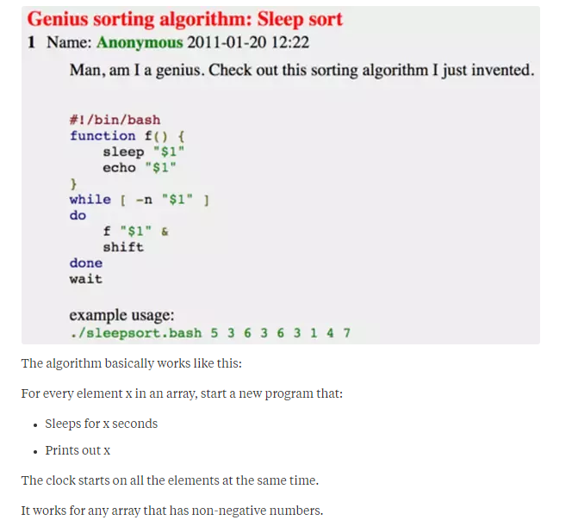

Sleep sort
For each element x in list:
sleep for x seconds
print out x
Output will be sorted list
Notes:
Go over this briefly. This one is also just for fun. It kind of works, but it breaks down when it has to scale (like several things in computer science).

Slide 18
Summary
Lists in Python hold data in a specific order, accessible by index
Dictionaries in Python hold key-value pairs (value accessible by key)
Sorting Algorithms manipulate data and put it in order
Many sorting algorithms exist
The type of data helps determine the best algorithm to use
Generally, there is no need to implement your own algorithm
Almost all languages have built-in “sort” functionality

Slide 19
Questions?

